Slide 1


Topic :AI-Driven Crop Disease Prediction and Management System Domain : Agriculture Team ID : T151 Team name : SCAN Team members : K Nikshitha(2303A51692) M Chandhana(2303A51688) P Ashwitha(2303A51163) N Soukya(2303A51401)

Slide 2

Objective
The objective of the AI-Driven Crop Disease Prediction and Management System is to develop an intelligent platform that leverages machine learning and real-time data analysis to detect, predict, and manage crop diseases. The system aims to:
Enhance Early Detection – Utilize AI-based image recognition and environmental data to identify potential crop diseases before they spread.

Slide 3
Provide Actionable Insights – Offer farmers accurate disease diagnoses, preventive strategies, and treatment recommendations.
Improve Yield and Reduce Losses – Minimize financial losses by enabling timely intervention and effective disease management.
Increase Accessibility – Develop a mobile and web-based application that ensures farmers can easily access and utilize the system from any location.
Leverage Real-Time Data – Integrate weather conditions, soil health, and other environmental factors to improve prediction accuracy.
Empower Farmers with AI – Equip farmers with advanced tools and data-driven decision-making capabilities for sustainable agriculture.

Slide 4
Problem Statement
🚜 The Problem: Crop Diseases Harm FarmersCrop diseases can destroy crops, leading to huge financial losses. Farmers often notice diseases too late, making it hard to save the crops.

Slide 5
⚠ Challenges Farmers Face
🕐 Late Detection By the time symptoms appear, the disease has already spread.
🚫 No Expert Help Nearby Many farmers don’t have quick access to plant disease experts
❌ Wrong Treatments Farmers may use the wrong pesticides or fertilizers, wasting money.
👀 Hard to Monitor Large Fields Checking crops manually takes too much time and is not always accurate.
🌦 Weather & Soil Conditions Matter Farmers lack real-time weather and soil health data to predict diseases.
🌱 The Need for a Smart Solution We need a smart AI-based system that can:
✅ Detect diseases early using images.
✅ Give instant, expert-level advice on treatment.
✅ Provide real-time data on weather and soil health.

Slide 6
Existing system
Existing System for Crop Disease Detection
🔍 Current Methods in Use
⿡ Manual Inspection – Farmers visually check crops for signs of disease.
⿢ Agricultural Experts – Consulting plant pathologists or agricultural extension officers.
⿣ Traditional Pesticide Use – Farmers apply general pesticides without precise disease identification.
⿤ Basic Mobile Apps – Some apps provide limited disease identification but lack accuracy and real-time analysis.

Slide 7
⚠ Limitations & Inefficiencies
🚫 Late Detection – Diseases are often noticed too late, causing crop damage.
🚫 High Cost & Time-Consuming – Consulting experts or manually checking large fields takes time and resources.
🚫 Misdiagnosis – Farmers may apply the wrong treatment due to lack of precise identification.
🚫 No Real-Time Data – Current methods do not integrate environmental factors like weather and soil conditions.

Slide 8
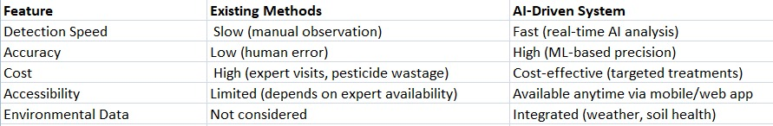
📊 Comparison Table: Existing vs. AI-Driven System

Slide 9
Proposed system
🌱 Proposed System: AI-Driven Crop Disease Prediction and Management🚀 Introducing the AI-Based SolutionThe proposed system is an AI-powered mobile and web application that analyzes crop images and real-time environmental data to predict, detect, and manage crop diseases. It helps farmers take early action, reducing crop damage and increasing yield.

Slide 10
🔍 Advantages Over Existing Systems
✅ Faster Disease Detection – AI identifies diseases instantly, unlike manual inspection.
✅ Higher Accuracy – Uses machine learning to reduce misdiagnosis.
✅ Cost-Effective – Saves money by suggesting precise treatments.
✅ Real-Time Monitoring – Integrates environmental factors like weather and soil health.
✅ Accessible Anytime, Anywhere – Farmers can use the mobile/web app without expert dependency.
⚙ Key Features & Functionalities
📸 AI-Based Image Recognition Farmers upload a photo of the affected crop.The AI model identifies the disease with high accuracy.
📊 Real-Time Environmental Data Integration Uses weather conditions and soil health data to improve prediction. Alerts farmers about possible outbreaks.
💡 Actionable Insights & Recommendations Provides treatment suggestions based on AI analysis. Suggests preventive measures to avoid future infections.
📱 Mobile & Web Application Accessible from any device. User-friendly interface for easy navigation.

Slide 11
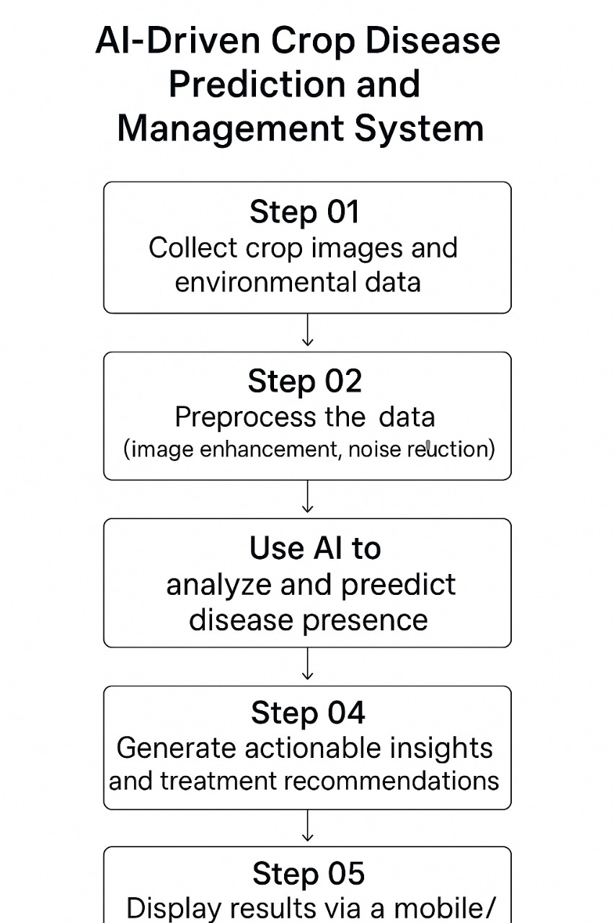
Workflow

Slide 12
System Architecture
Tech Stack
Languages used
Frontend: React Native (for mobile app) and ReactJS (for web app)2. Backend: Python (using Flask or Django framework)3. Machine Learning: Python (using TensorFlow, Keras, or PyTorch libraries)
Data base used
Relational Database: MySQL or PostgreSQL (for storing user data, crop information, and disease data)
2. NoSQL Database: MongoDB (for storing image data and environmental sensor readings)
Database security
Encryption: Use SSL/TLS encryption for data in transit and at rest.2. Authentication: Implement user authentication using OAuth or JWT.3. Authorization: Use role-based access control to restrict access to sensitive data.4. Regular Backups: Schedule regular backups to prevent data loss.
Cloud Service Used for Hosting
1. Amazon Web Services (AWS): Use AWS Elastic Beanstalk for deploying the web app and AWS Lambda for serverless computing.
2. Google Cloud Platform : deploying the web app and GCP Cloud Functions for serverless computing.
.

Slide 13
API’s used
API's Used1. Image Analysis API: Use Google Cloud Vision API or Amazon Rekognition for image analysis and disease detection.2. Weather API: Use Open WeatherMap API or Dark Sky API for retrieving environmental data.3. Machine Learning API: Use TensorFlow API or PyTorch API for building and deploying machine learning models.

Slide 14
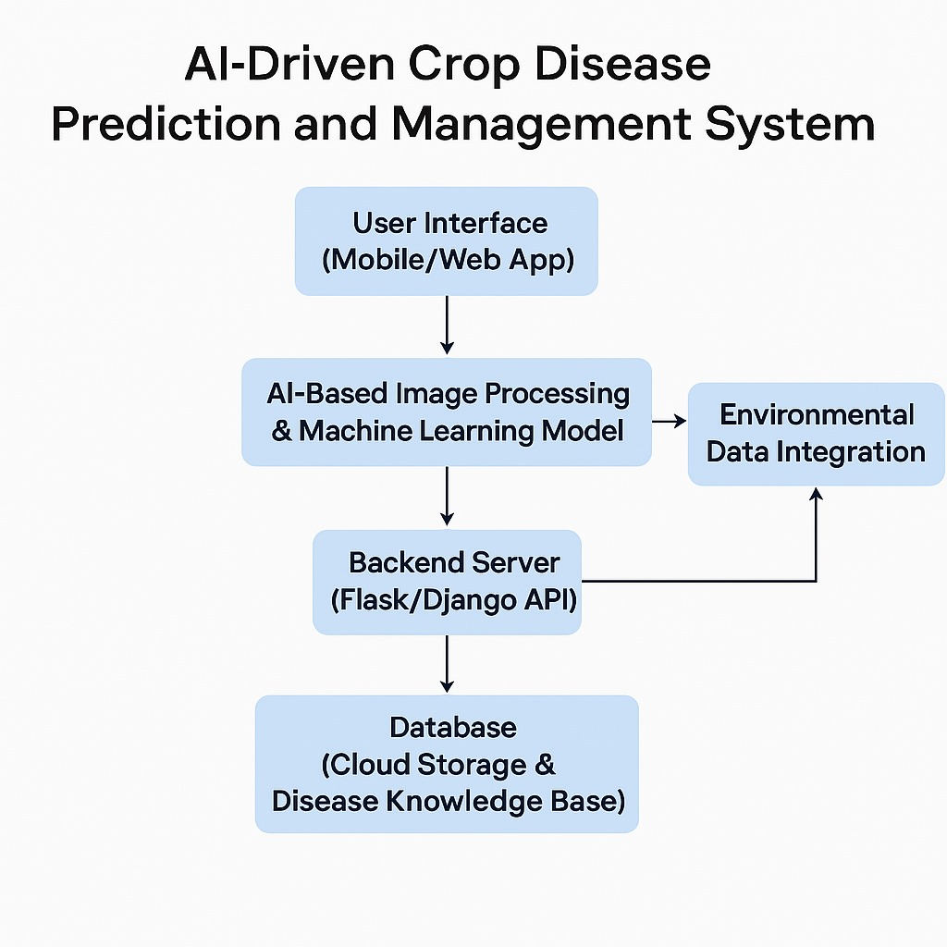
Key points to cover

Slide 15
Conclusion & Future Scope
The AI-Driven Crop Disease Prediction and Management System helps farmers detect crop diseases early and take quick action to protect their crops.
By using artificial intelligence, the system analyzes crop images and environmental data to identify diseases and suggest the best treatments.
With both mobile and web applications, farmers can easily upload pictures of their crops and get instant disease diagnoses and recommendations.
This helps them prevent major losses and reduce unnecessary pesticide use, leading to healthier crops and better yields.

